Slide 1
Predict Response Times for NYC Service Requests
Presented by Rick Azzi

Slide 2
Table of contents
1 - Introduction
2- Data Acquisition
3- Data Exploration
4- Data Preprocessing
5- Visualizations
6- Feature Engineering and Data Transformation
7- Model Training and Evaluation
8- Model Improvement
9- Conclusion

Slide 3
Introduction
The 311 Service Requests from 2010 to Present dataset is a comprehensive record of non-emergency complaints and service requests made by New York City residents, covering a wide range of issues such as noise, sanitation, and street conditions.
The aim is to clean and transform this data into a usable format to build a predictive model capable of accurately forecasting response times for various types of complaints. Ultimately, this model will empower NYC service agencies to anticipate delays, allocate resources more effectively, and improve overall operational efficiency, leading to faster resolutions and enhanced public satisfaction.

Slide 4
Data Acquisition
The dataset used in this project is sourced from the NYC Open Data website and contains 39 million rows and 47 columns . It provides comprehensive records of non-emergency service requests made by NYC residents, including details such as complaint types, locations, date, and agency actions.
To acquire the 311 Service Requests dataset , I utilized the NYC Open Data API, which provides access to the data. Given the massive size of the dataset, downloading it in its entirety at once would have been impractical and inefficient. To address this challenge, I implemented a chunk-based data retrieval approach. To save time and computational resources, all steps in this project were saved as chunks in a new directory. This approach prevented the need to rerun the code, which would have been time-consuming due to the large size of the dataset.

Slide 5
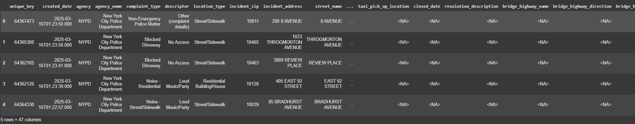
Data Exploration
To gain a comprehensive understanding of the dataset, I performed an initial exploration to assess its structure, quality, and contents.
Checking the Dimensions : Verified the number of rows and columns to ensure the dataset was complete.
Previewing the Data : Printed the first few rows to examine the structure and identify key features such as complaint_type, incident_zip, and date columns.
Validating Column Types : Reviewed the data types of each column to identify potential inconsistencies, such as mixed types in certain fields (e.g., start_date,closed_date).
Ensuring Completeness : Confirmed that all expected columns were present and aligned with the project requirements.

Slide 6
Data Preprocessing
During the preprocessing phase, I performed several critical steps to ensure the dataset was clean and ready for modeling.
Dropped unnecessary columns that did not contribute to the analysis, reducing the dimensionality of the dataset.
Checked for missing values and calculated their percentages for each column, identifying key areas that required attention. Upon analysis, I found that certain columns had more than 70% null values which significantly reduced their utility for modeling. To maintain data integrity and focus on high-quality inputs, I decided to drop these columns rather than retain incomplete or unreliable data. For the remaining columns with manageable levels of missing values, I addressed the gaps through appropriate imputation or removal strategies, ensuring the dataset was robust and ready for further analysis.
Checked for duplicates and removed them.
Addressed outliers to improve the quality of the dataset.
Created the target column “response_time”. A key challenge arose when creating the target variable.
Initially, I intended to calculate response time as the difference between the created_date (start date) and closed_date (closure date) of the Complaint. However, the closed_date column had 71% null values, making it unreliable and unprofessional to use for this purpose. Instead, I used the resolution_action_updated_date column, which represents the date when the responding agency last updated the service request (SR), which means the date they responded. By calculating the difference between created_date and resolution_action_updated_date, I successfully created a robust and accurate ‘response_time’ (in minutes) column that reflects the time taken to respond to the complaint.

Slide 7
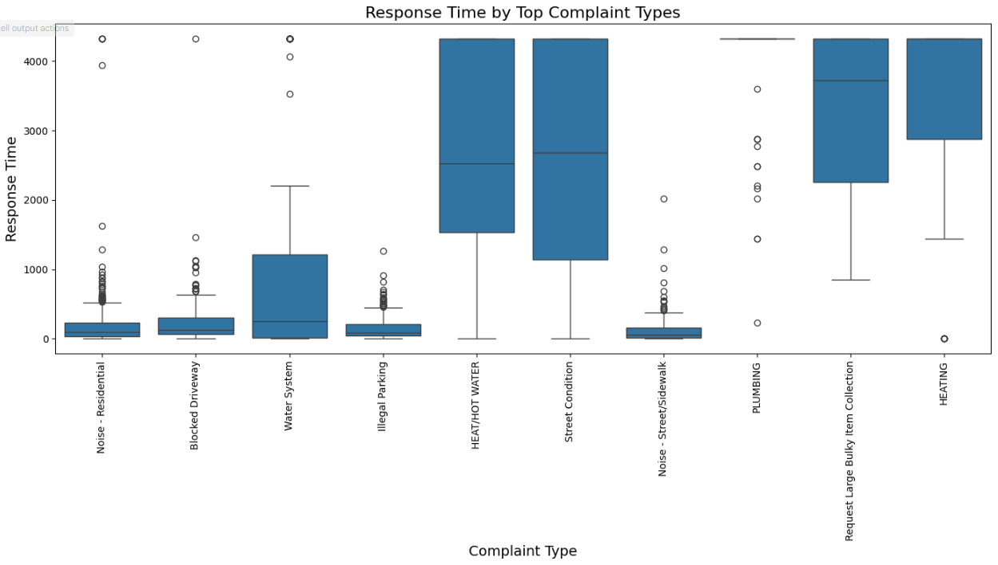
Visualizations
Visual Insights: Exploring Patterns and Trends in the Data (Note:‘response_time’ is in minutes)

Slide 8
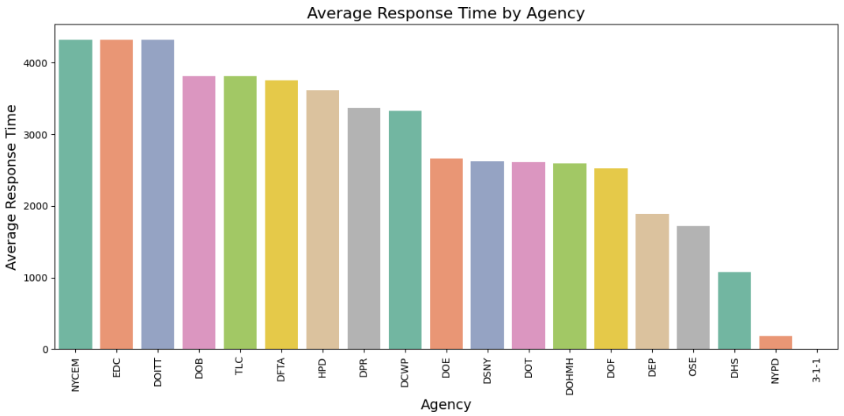
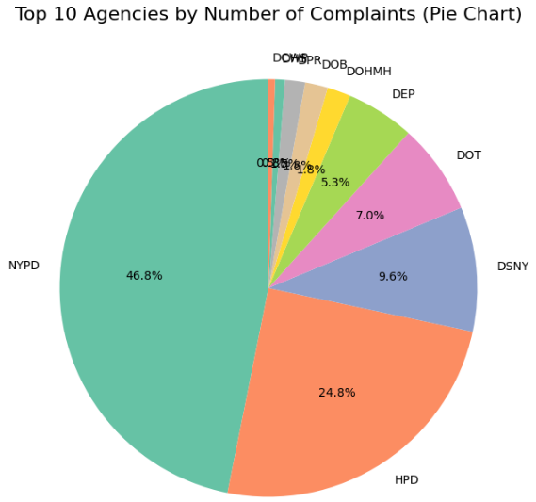
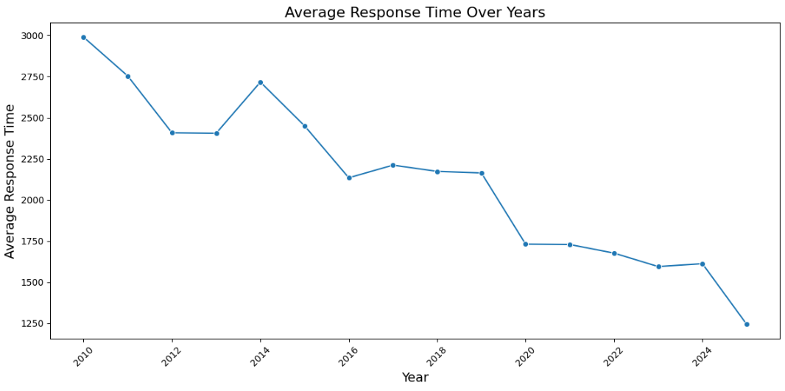
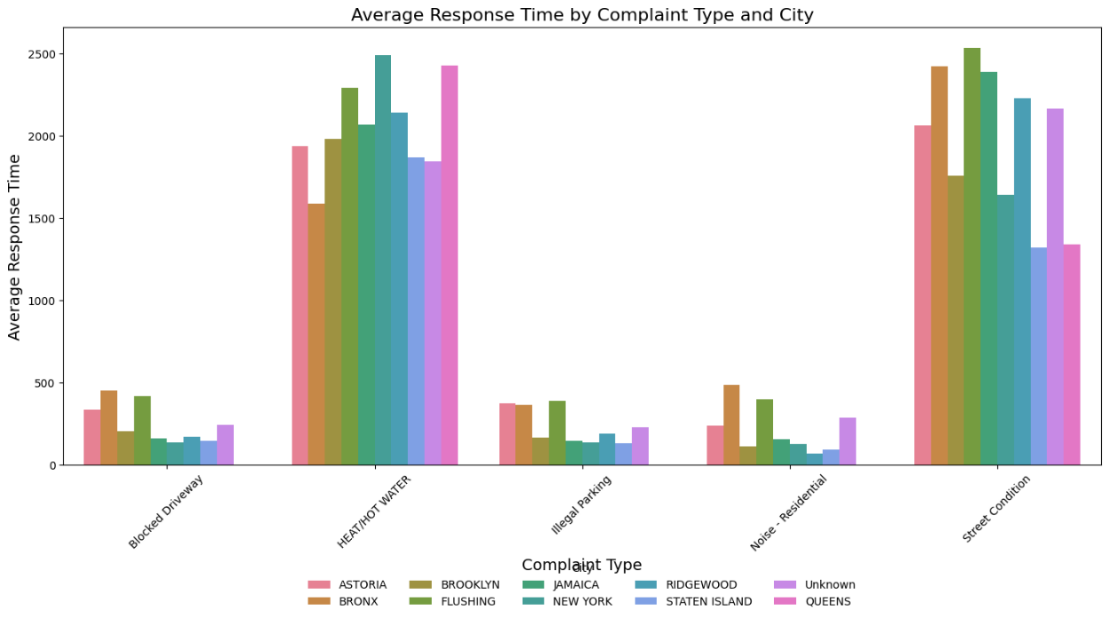

Slide 9
Feature Engineering and Data Transformation
In the Feature Engineering and Data Transformation Pipeline , I performed several key steps to prepare the dataset for modeling.
- Converted some column types to ensure consistency, such as transforming date/time columns into datetime formats and numeric columns into appropriate numeric types.
- Extracted useful features from existing columns, including deriving created_year, created_month, created_day, and created_hour from the created_date column to capture temporal patterns.
- Encoding to handle categorical variables, using one-hot encoding for low-cardinality columns and target encoding for high-cardinality columns, ensuring efficient representation of categorical data.
- Normalization on numeric features to standardize their scales, improving model performance and convergence during training.

Slide 10
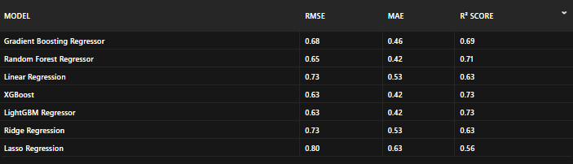
Model Training and Evaluation
In the Model Training and Evaluation phase:
- I split the dataset into training and testing sets using an 80-20 split to ensure robust evaluation.
- I trained the data on 7 different regression models , including Gradient Boosting Regressor, Random Forest Regressor, Linear Regression, XGBoost, LightGBM Regressor, Ridge Regression, and Lasso Regression.
- After training, I evaluated each model using key metrics: Root Mean Squared Error (RMSE) , Mean Absolute Error (MAE), and R² Score .
- The results showed that XGBoost and LightGBM Regressor performed the best, achieving the lowest RMSE (0.63) and MAE (0.42), along with the highest R² Score (0.73). Other strong performers included the Random Forest Regressor (RMSE: 0.65, R²: 0.71). Simpler models like Linear Regression , Ridge Regression , and Lasso Regression demonstrated lower performance, with Lasso Regression showing the highest errors (RMSE: 0.80, R²: 0.56).
- Based on these results, I selected LightGBM Regressor as the final model due to its balance of accuracy and efficiency.
Models Results

Slide 11
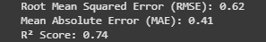
Model Improvement
In this section, I implemented several enhancements to improve the chosen Model, LightGBM Regressor model performance and robustness. First, I ensured the dataset was cleaner and aligned with the expected feature structure, which reduced mismatches and improved consistency. I also fine-tuned the model using optimized hyperparameters and incorporated early stopping to prevent overfitting. Additionally, I evaluated the model using multiple metrics (RMSE, MAE, R²) to get a comprehensive understanding of its performance. Finally, I saved the enhanced model in a dedicated directory for better organization. These changes resulted in a more accurate and reliable model
Enhanced Model Results

Slide 12
Conclusion
This project successfully delivered a robust predictive model capable of forecasting response times for NYC service requests with strong performance metrics (RMSE: 0.63, R²: 0.73). Our work demonstrated rigorous data preprocessing, feature engineering, and model evaluation, ensuring the model is both accurate and reliable. Importantly, the model was tested on new, unseen data to confirm its real-world applicability, proving its ability to handle diverse scenarios effectively. This tool is valuable for NYC service agencies, empowering them to allocate resources more efficiently, prioritize critical complaints, and reduce delays ultimately improving public satisfaction and operational efficiency. By leveraging this model, agencies can make data-driven decisions that enhance their responsiveness and better serve the community.

